Slide 1
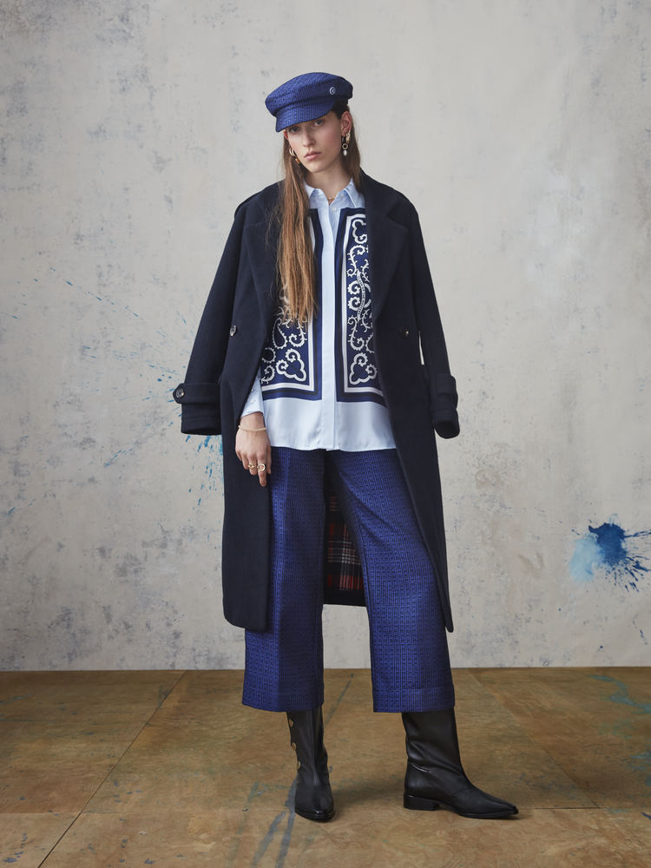
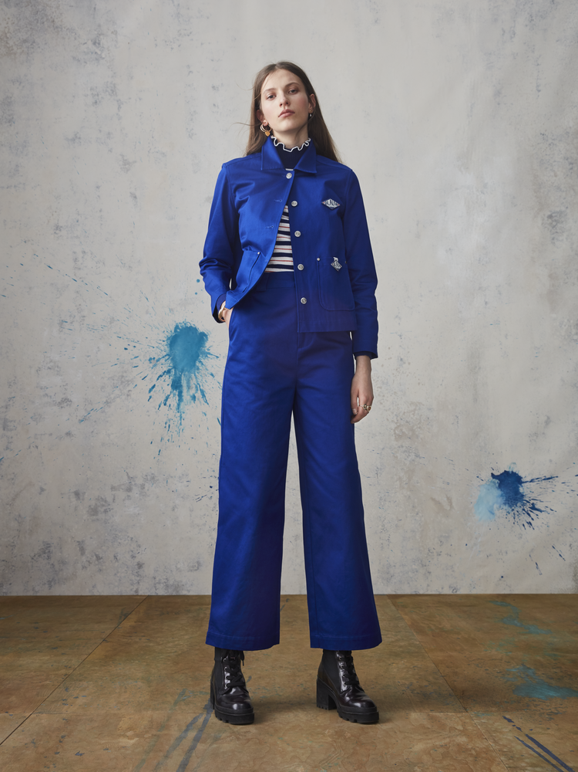

Scotch & Soda
PS20 Amsterdams Blauw - The Underground Blues
Ladies
May, 2019
PS20 Amsterdams Blauw takes a look back through art history and finds inspiration by way of two gangs of master painters. Pack number one is led by impressionist master Pablo Picasso. Set in the early 1900s, Picasso and his overall-clad, paint-splattered contemporaries burst onto the Parisian scene with their every-shade-of-blue renderings of the world around them. Sixty years later, across the Atlantic, a second gang is forming in grungy Lower East Manhattan - hosted by Andy Warhol at The Factory.
Despite being separated by decades and oceans, the two masters and their respective gangs are connected by the same fiery ambition and ideology: both gangs forge new genres and break open art for the masses. These two gangs and their unique code for creativity sets the scene for a new season; a riotous adventure of passion, colour and
culture with always an Amsterdams Blauw signature wink.
SCOTCH & SODA | KEIZERSGRACHT 105 | 1015 CH AMSTERDAM | THE NETHERLANDS | SCOTCH-SODA.COM

Slide 2
Cross collection themes
-Ams Blauw classics
A capsule of iconic denim-minded pieces ranging from the perfect classic jean and matching jacket to the most covetable crisp, white shirt. Each Ams Blauw classic is issued with its own special hang tag.
-Re-spun classics
Such as pinstripes and checks.
-Tailored denim
Pinstripes in all executions, city corduroy, rib cord, drapey fabrics – all finished with elegant tailoring
-Bandana art
Deconstructed bandana placements and allover prints – issued with special hang tags.
-Continued focus on sustainability
Designing with organic cotton and embracing more sustainable washes.
-A new take on denim workwear
Fresh colours, new artworks, rich and unexpected mixing of qualities.
-Masterclash – when Andy and Pablo meet
Neon-meets-neutral, clash of the unexpected, multiple-textures in one, and tone-on-tone colour..
The Blue Period
Underpinned by Picasso’s blue period, this drop is grounded in the artist’s favourite hue. Sometimes clear and deep; other times pastel and powdered – we see the world through blue eyes.
Deconstructed bandana art is our homage to Pablo Picasso, who always wore one. We see bandana art in everything from allover print playsuits to elegant panels on silky shirts. And, from colourful bandana-florals to artful detailing on denims. Bold hand-script artworks and artisanal scribbles are other key treatments that add new season twists to our contemporary take on Parisian chic.
The denim and pant direction ranges from workwear inspired silhouettes with matching jackets to more tailored takes on utility pieces – like the textured, blue rib cord suit.
The November colour card is a Picasso-inspired blend of blues: from sugar blue through to boldest, brightest take. A tight palette of French whites and blues gets an extra spectrum of red; from darker bandana red through to bright tomato red. For women and girls, we add an extra touch of pink and a purple called ‘le mauve’.
SCOTCH & SODA | KEIZERSGRACHT 105 | 1015 CH AMSTERDAM | THE NETHERLANDS | SCOTCH-SODA.COM

Slide 3
The Blue Period key styles:
Women’s denims
-Petit Ami in ‘bandanarama’ – with an all-over bandana print
-Petit Ami ‘Signed by Blauw’ – classic green-based indigo cast with bandana print detailing at the hem
-Extra Boyfriend in ‘ecru love’ – a vintage-appeal ecru
-The Keeper in ‘true blue’ – straight-cut denim contrasted with subtle side seam frill tape detail
Women’s tops and outerwear
-Silky shirt with bandana art – in pastel blue with navy blue bandana panels
-Bandana allover playsuit – with drapey v neckline
-Bandana jacquard knit – a crew-neck sweater featuring the season’s standout print
-Crisp funnel-neck statement shirt – with pinstripes, back closure and woven top
-Ecru alpaca trucker jacket – soft alpaca wool in a winter white hue
Factory Culture
Amsterdams Blauw’s December delivery is a full-colour, mixed-media explosion inspired by Andy Warhol and The Factory. Expect a mash-up of arthouse artworks and prints.
Classic themes such as pinstripes and checks are given fresh perspectives thanks to treatments that nod to Warhol-esque screen-printing. New colourways featuring shots of neon, innovative fabric applications and unexpected mixing of qualities are other techniques that work magic for effortless, NYC-street appeal.
The colour palette sees blacks, whites and ecrus mix with neutrals and neons. Earthy rusts, brick red and retro-yellow clash with pop-art fluoro pinks and yellows, while tones of khaki and military add toughness.
Factory culture key styles:
Women’s denim
-Premium rib cord workwear pant in bright blue – a cropped, wide fit
-The Keeper in ‘overdyed stripe’ – black denim overdyed with arthouse pink vertical stripes
-Indigo cargo pant – high-waist with a fine pinstripe
-Sugar blue denim workwear skirt in ‘sacre bleu’ – with button front and studs
-Seasonal crop flare in ‘sacre bleu’ – a high-rise waist with a pressed frill hemline
-Seasonal plissé denim in ‘mix not match’ – a very wide-leg denim on the front side and plissé pant on the backside
-Studded trucker jacket – deep, raw denim with studded detailing and cuffs
SCOTCH & SODA | KEIZERSGRACHT 105 | 1015 CH AMSTERDAM | THE NETHERLANDS | SCOTCH-SODA.COM

Slide 4
Women’s tops and outerwear
-Teddy coat – an oversized shape in a soft, camel-hued teddy
-Bright blue workwear jacket – Premium workwear quality, comes with matching workwear pant
-Oversize soft pink hoodie – featuring Ams Blauw indigo underground artwork
-Oversize , knee-length check shirt – with near-neon oranges and reds
-Ecru and black zip-front knit – funnel neck with vertical stripes
Scotch & Soda Club Nomade
Club Nomade is gym inspired design, made for everywhere but the gym. Comfort sweats with an extra dose of tailoring for easy style in down time. Created as a tight, travel-ready capsule, Club Nomade sports-neutral base shades are accented each season with a fresh pop of colour.
For PS20, the capsule’s off-duty basics play with the idea of easy-going Sundays in super-soft and oversized separates. Après gym on-the-go-layers are inspired by technical parkas, and fabrications move in a cleaner, more tailored direction for a comfortable take on dressed-up style.
The capsule’s base palette of white, ecru, sand and black is paired with a neon pink detail shade.
Scotch & Soda Club Nomade key pieces:
-Ripstop pant with draw cords
-Fitted sweat skirt with asymmetric zipper
-Crepe-inspired tee with draw cord details
-Chic tailored pants with tuxedo stripe
-Cotton cashmere knit with contrast panel and zippered side
About us
Scotch & Soda are inspired by the world and curated by Amsterdam. A team of passionate discoverers and collectors, scouring the globe for that painting, poem, vintage piece, ruin, or artefact that sparks our never-ending curiosity. Treasures uncovered on worldly wanders are poured into collections and signature looks that clash eras, classics, places of inspiration, meshing unexpected fabrics and patterns. Men’s, women’s and children’s all start life at our canal-side design studio in a former church in the heart of Amsterdam. Scotch & Soda has over 200 stores, and can be found in over 8000 doors including the best global department stores and independents, and in our webstore.
SCOTCH & SODA | KEIZERSGRACHT 105 | 1015 CH AMSTERDAM | THE NETHERLANDS | SCOTCH-SODA.COM

